Slide 1
Feature: Individual measurable property or characteristic of a phenomenon being observed

Slide 2
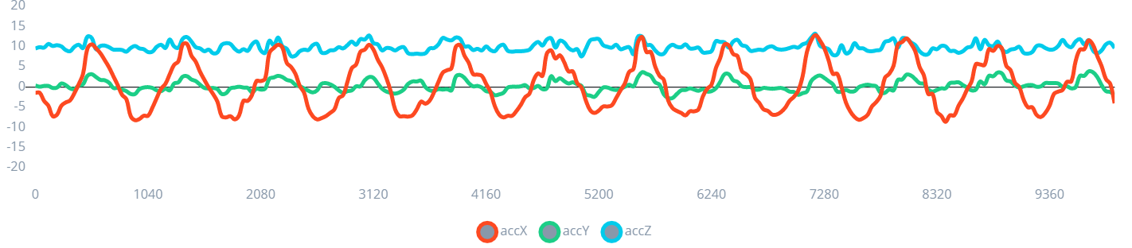
Feature Example
Acceleration (m/s²)
Model
x | -1.4
y | 0.4
z | 9.6
Left-right
Up-down
Circle
Idle

Slide 3
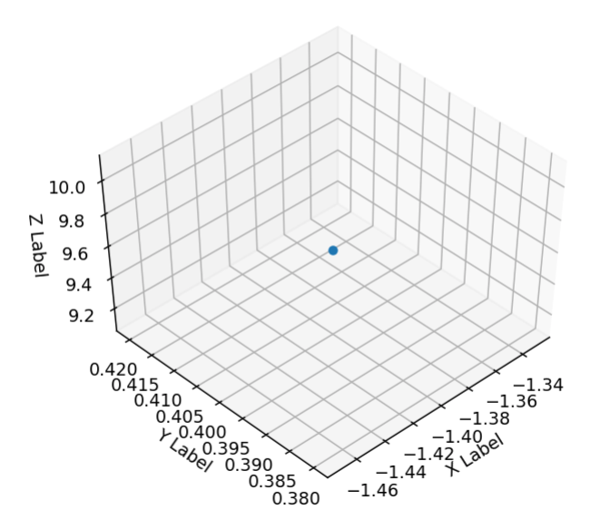
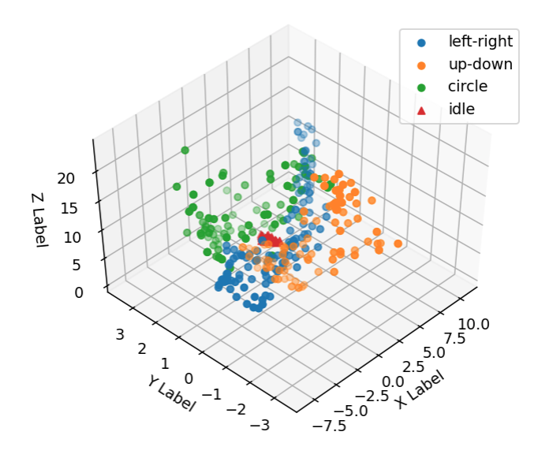
1 (x, y, z) accelerometer point from “left-right” sample
Many (x, y, z) accelerometer points from all classes

Slide 4
Feature Example
2 second window
Acceleration (m/s²)
...
Model
x | -1.4 | -1.4 | -2.8 | -3.4 | -4.0
y | 0.4 | 0.4 | 0.1 | 0.2 | 0.3
z | 9.6 | 9.6 | 9.9 | 9.7 | 9.8
...
Left-right
Up-down
Circle
Idle
...
...
125 samples for each axis
...
375 total inputs to the model!

Slide 5
Problems with deep learning
High-dimensional inputs
Computational complexity
Requires lots of training data
Neural network for extracting features
Neural network for classifying
Class 1
Class 2
Class 3
Class 4

Slide 6
Feature Example
2 second window
Acceleration (m/s²)
...
x_{RMS} = 5.7 m/s² (RMS)
...
Feature extraction:
Calculate RMS for each axis
Model
x | -1.4 | -1.4 | -2.8 | -3.4 | -4.0
y | 0.4 | 0.4 | 0.1 | 0.2 | 0.3
z | 9.6 | 9.6 | 9.9 | 9.7 | 9.8
Left-right
Up-down
Circle
Idle
y_{RMS} = 1.2 m/s² (RMS)
...
z_{RMS} = 9.9 m/s² (RMS)
...
...
375 raw values
3 model input values

Slide 7
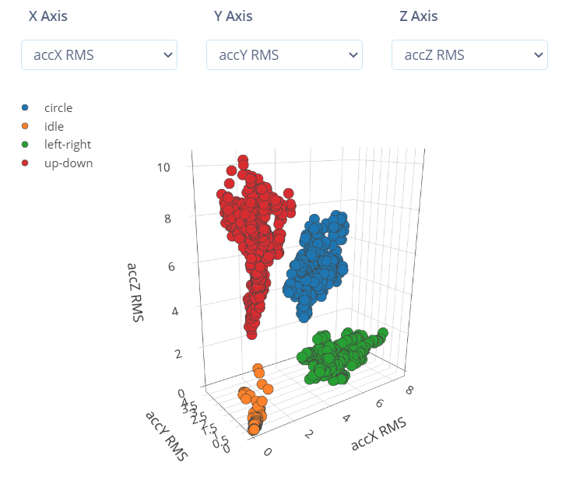

Slide 8
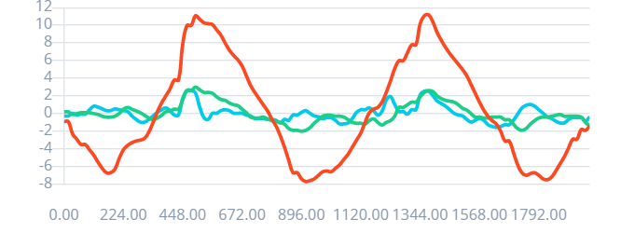
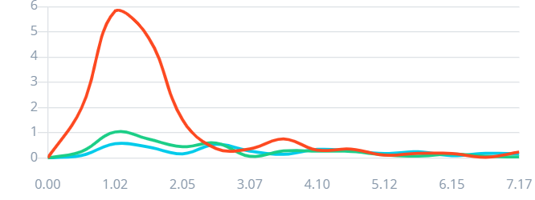
m/s²
Time domain
ms
Feature extraction:
FFT
m/s²
Frequency domain
Hz

Slide 9
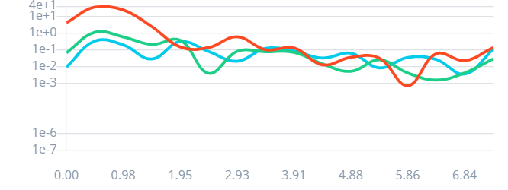
m/s²
Power Spectral Density (PSD)
ms
[m/s²]²/Hz
Feature extraction:
FFT
m/s²
Hz
Feature extraction:
PSD
Hz

Slide 10
Feature Example
2 second window
11 features per axis: RMS, 3x peak amplitudes from PSD, 3x peak frequencies from PSD, 4x spectral bins
Acceleration (m/s²)
...
Model
x | -1.4 | -1.4 | -2.8 | -3.4 | -4.0
y | 0.4 | 0.4 | 0.1 | 0.2 | 0.3
z | 9.6 | 9.6 | 9.9 | 9.7 | 9.8
...
Feature extraction:
RMS and Power Spectral Density (PSD)
Left-right
Up-down
Circle
Idle
33x features
...
...
...
375 raw values

Slide 11
Feature Example
2 second window
11 features per axis: RMS, 3x peak amplitudes from PSD, 3x peak frequencies from PSD, 4x spectral bins
Acceleration (m/s²)
...
Model
x | -6.8 | -5.6 | -4.6 | -4.1 | -3.8
y | -0.1 | 0.2 | 0.7 | 0.9 | 0.7
z | 10.4 | 10.3 | 10.2 | 10.1 | 9.6
...
Feature extraction:
RMS and Power Spectral Density (PSD)
Left-right
Up-down
Circle
Idle
33x features
...
...
...
375 raw values

